Slide 1

Mining Large Quasi-Cliques with Quality Guarantees from Vertex Neighborhoods
Aritra Konar
and
Nicholas D. Sidiropoulos
Department of Electrical and Computer Engineering
KDD 2020 Research Track

Slide 2
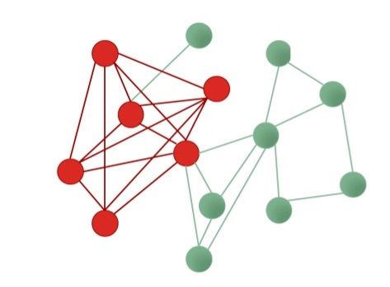
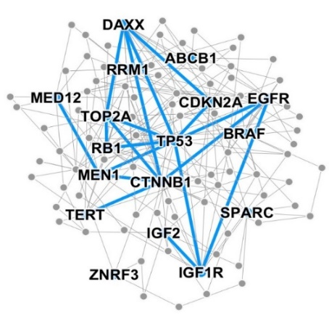
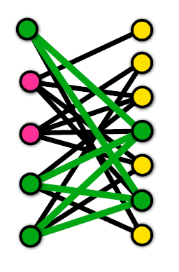
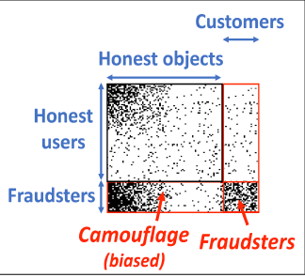
Dense Subgraph Discovery
Problem: Given a graph, find list of “dense’’ subgraphs
A key primitive in graph mining
Applications:
Detecting correlated genes
[Tsourakakis et al. 2013]
Anomaly detection in e-commerce
and social networks [Hooi et al. 2016]
Story identification in Twitter streams [Angel et al. 2012]

Slide 3
What is a dense subgraph?
Archetype: Cliques
NP-hard, restrictive definition
Other notions: Quasi-cliques
Core decomposition [Seidman 1983]
Average Degree [Goldberg 1984], k-Clique Densest Subgraph [Tsourakakis 2015]
Optimal Quasi-clique [Tsourakakis et al. 2013]
Algorithms:
Maximum-flow [Goldberg 1984, Tsourakakis 2015, Mitzenmacher et al. 2015]
Semidefinite Relaxation [Cadena et al. 2016]
Greedy [Charikar 2000, Batagelj-Zaversnik 2003, Tsourakakis et al. 2013, Tsourakakis 2015]
Local-search [Tsourakakis et al. 2013]

Slide 4

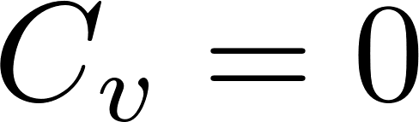
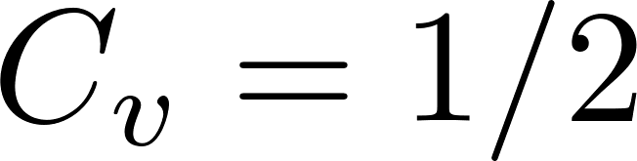
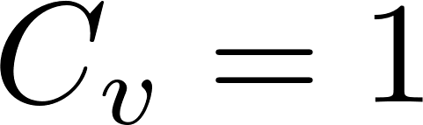
Our approach
Look at vertex neighborhoods!
List all triangles in graph [Schank 2005, Lapaty 2008, Suri-Vassilvitskii 2011]
Compute the local clustering coefficient (LCC) of each vertex
LCC = edge density of one-hop neighborhood of
Output neighborhood with highest LCC
But why do this?

Slide 5
Sneak peek…
Obtained a list of non-trivial (maximal) cliques and quasi-cliques without using any specialized methods!
---Clique returned by TDS
[Mitzenmacher et. al 2015]
---Max. degree

Slide 6
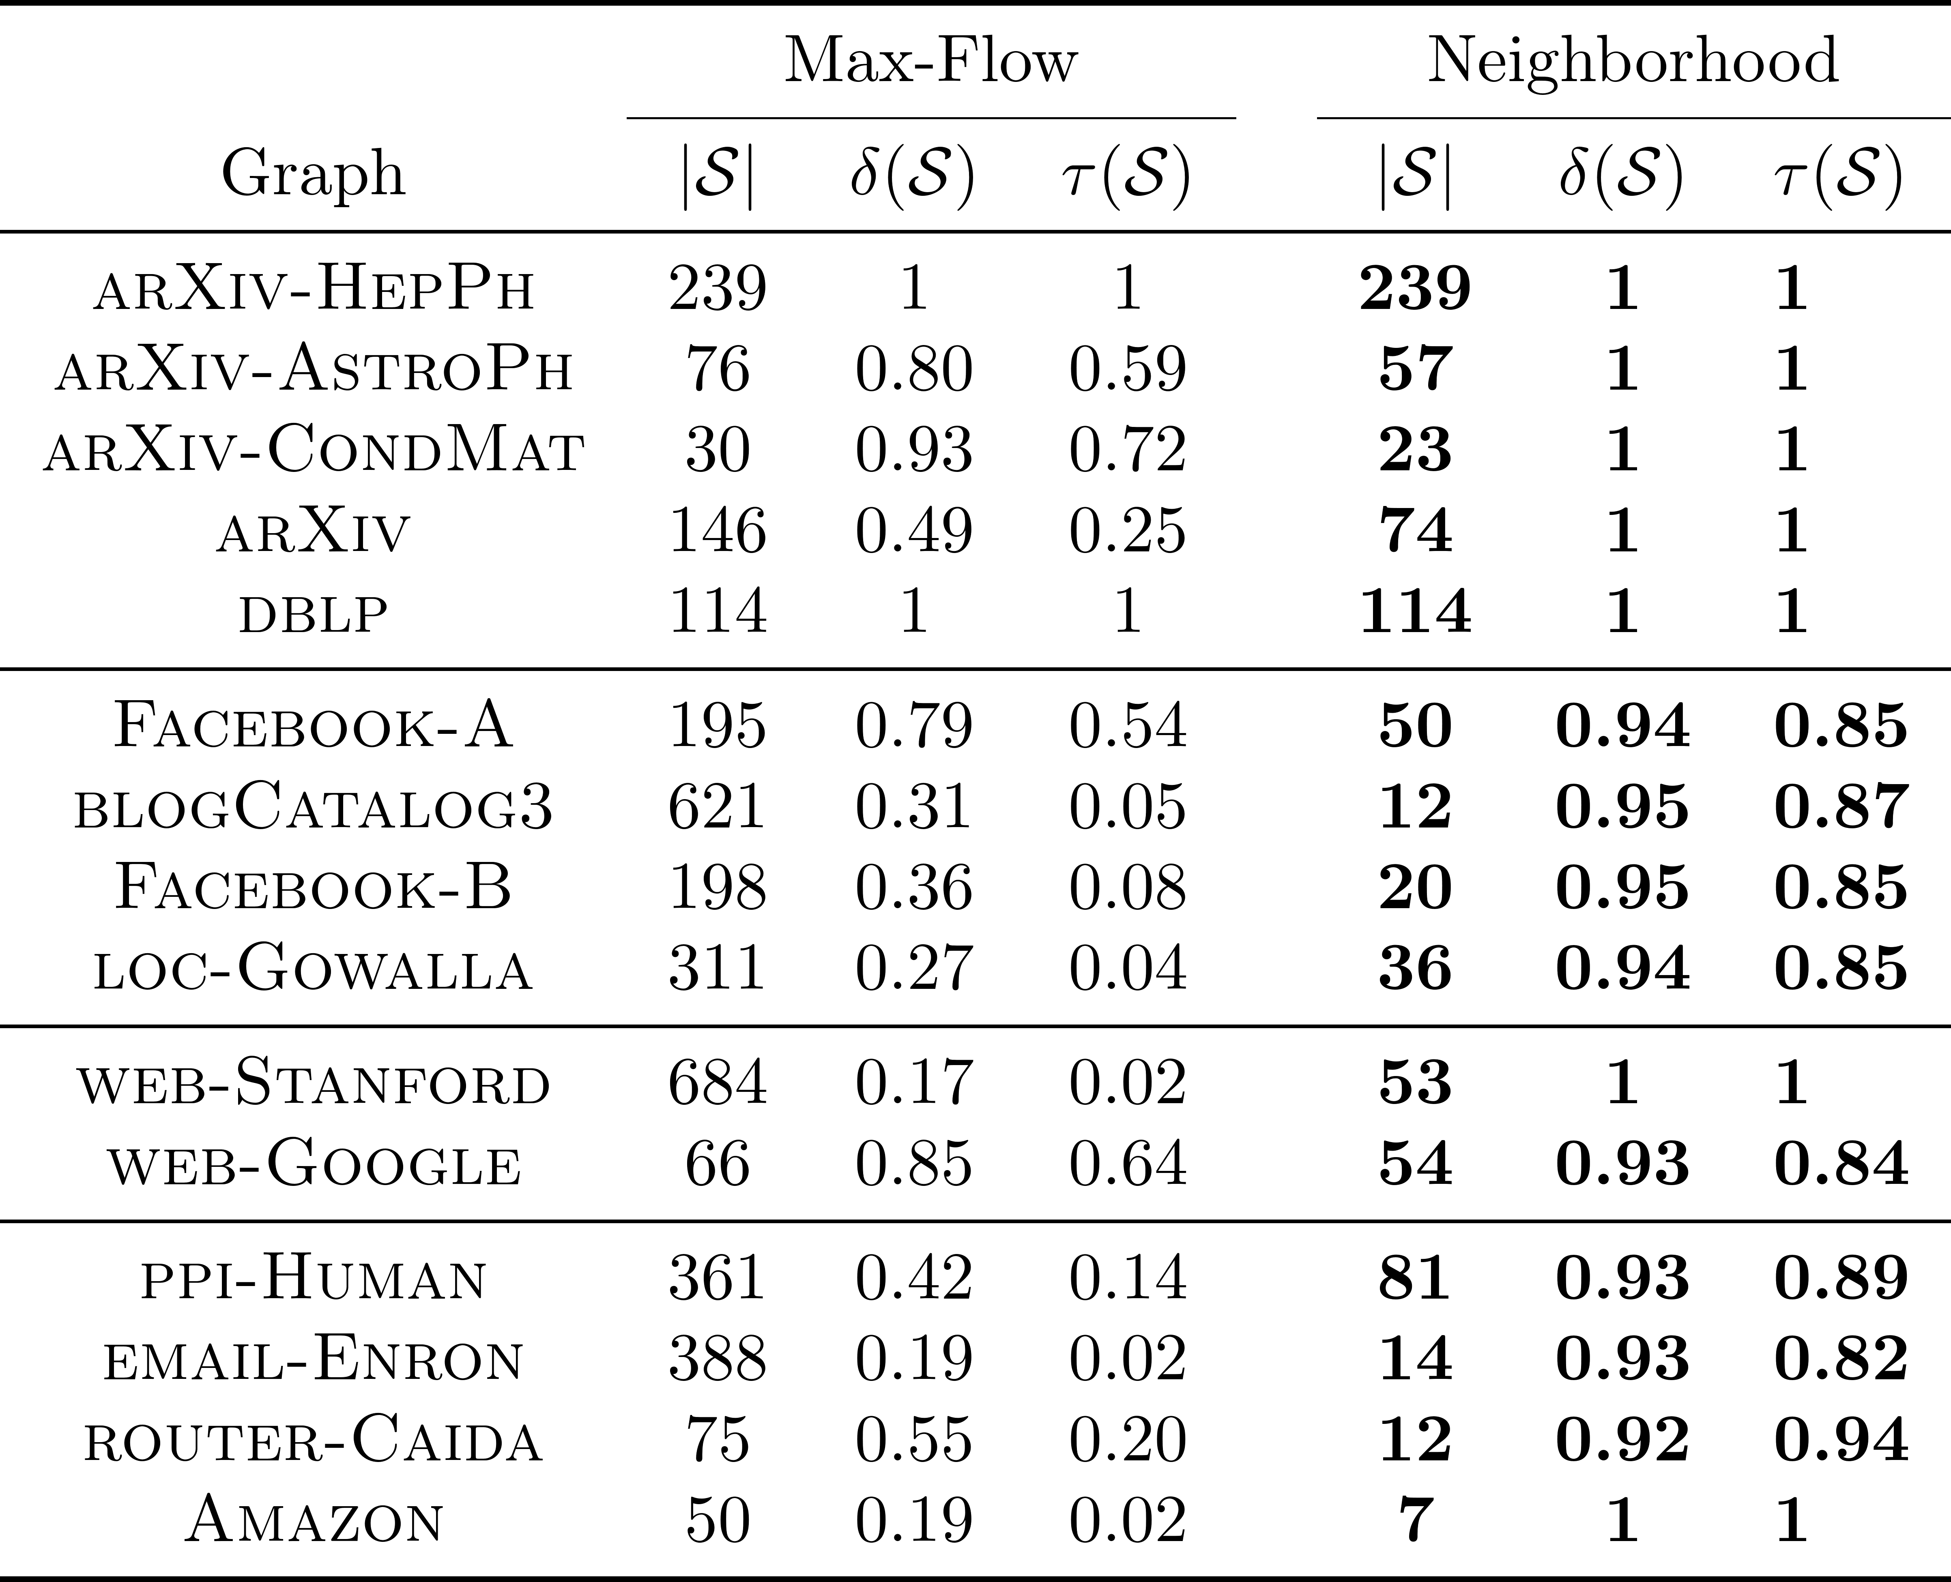
Sneak peek…
Comparison with triangle-densest subgraph [Tsourakakis 2015, Mitzenmacher et al. 2015]
Best neighborhood consistently outperforms dedicated algorithm!

Slide 7
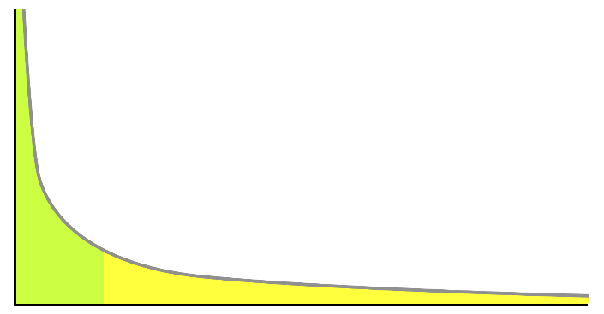
Why does this happen?
Observation:
Recurring traits of real-world graphs:
High clustering coefficients [Watts-Strogatz 98]
Power-law degree distributions [Faloutsos (x3) 99, Barabasi-Albert 99]
Main question:
Do these properties imply that vertex neighborhoods harbor dense subgraphs of non-trivial sizes?
Frequency
Degree

Slide 8
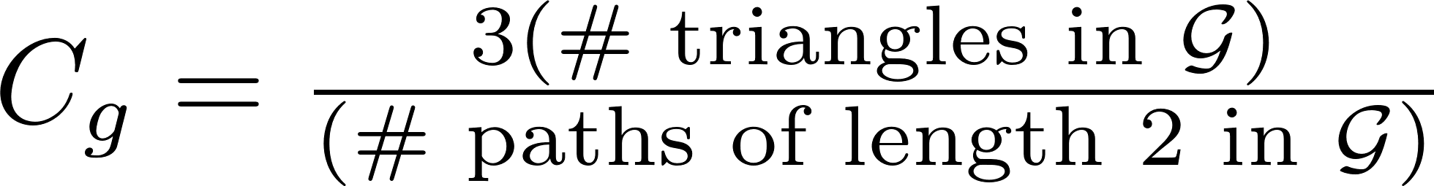
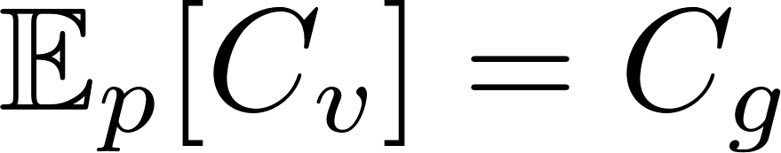
A note on clustering coefficients
Global clustering coefficient (GCC):
The probability that a path of length 2 has its endpoints closed
Useful Result: [Gleich-Seshadhri 12]
Define probability distribution on vertices
Then,

Slide 9
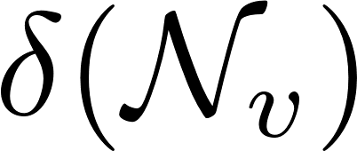
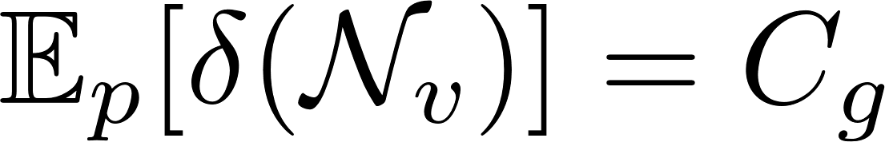
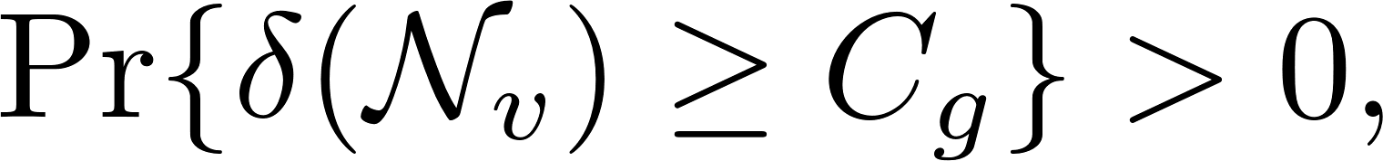
A note on clustering coefficients
Recall:
LCC = edge density of one-hop neighborhood
Corollary 1:
Since high GCC implies the existence of a vertex neighborhood with high edge-density
Corollary 2:
High GCC implies presence of many vertex neighborhoods with high edge-density

Slide 10
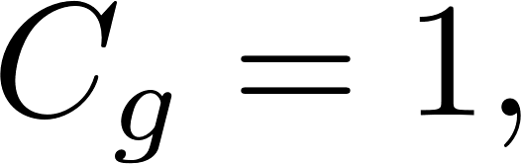
A note on clustering coefficients
Limitation:
High edge-density is necessary, but not sufficient for a neighborhood to be dense and of non-trivial size
Counter-example:
Although every neighborhood is simply an edge

Slide 11
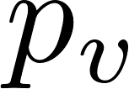
Vertex neighborhoods as dense subgraphs
Desiderata: Want to show existence of vertex neighborhood with
“High” edge-density
“large” size (degree)
Approach: Invoke the probabilistic method [Alon-Spencer 16]
Define pair of “bad” events
(A) vertex sampled with probability has a neighborhood with “low” edge-density
(B) vertex sampled with probability has a “small” degree
Suffices to show

Slide 12
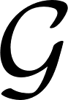
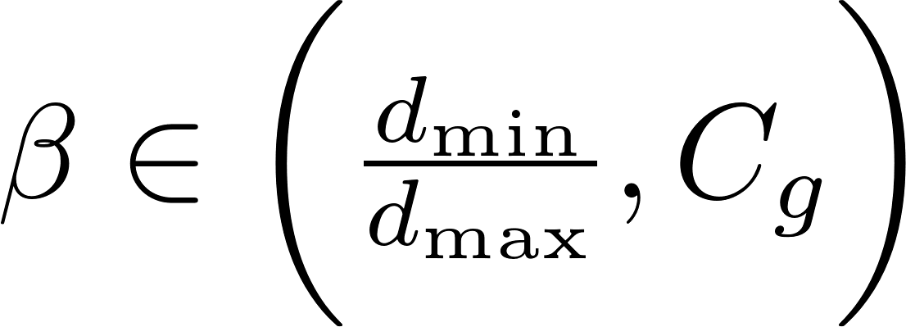
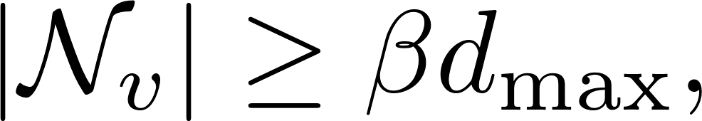
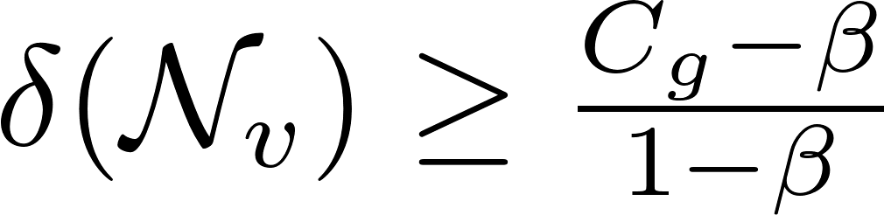
Vertex neighborhoods as dense subgraphs
Assumptions:
(A): obeys a power-law distribution with exponent 2
(B): has no missing degrees
Main theorem:
For every choice of
there exists a vertex neighborhood of size
and edge-density
Take-away: high GCC and power-law distributions imply the presence of dense neighborhood subgraphs

Slide 13
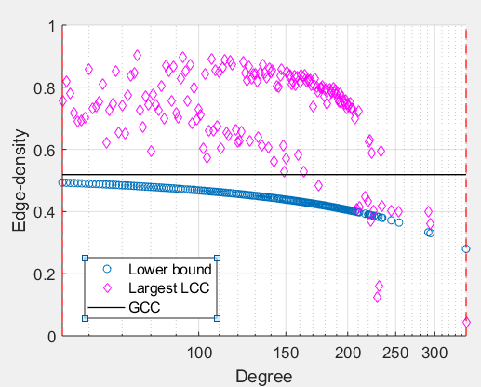
Vertex neighborhoods as dense subgraphs
Illustration: Facebook graph
Range of admissible degrees

Slide 14
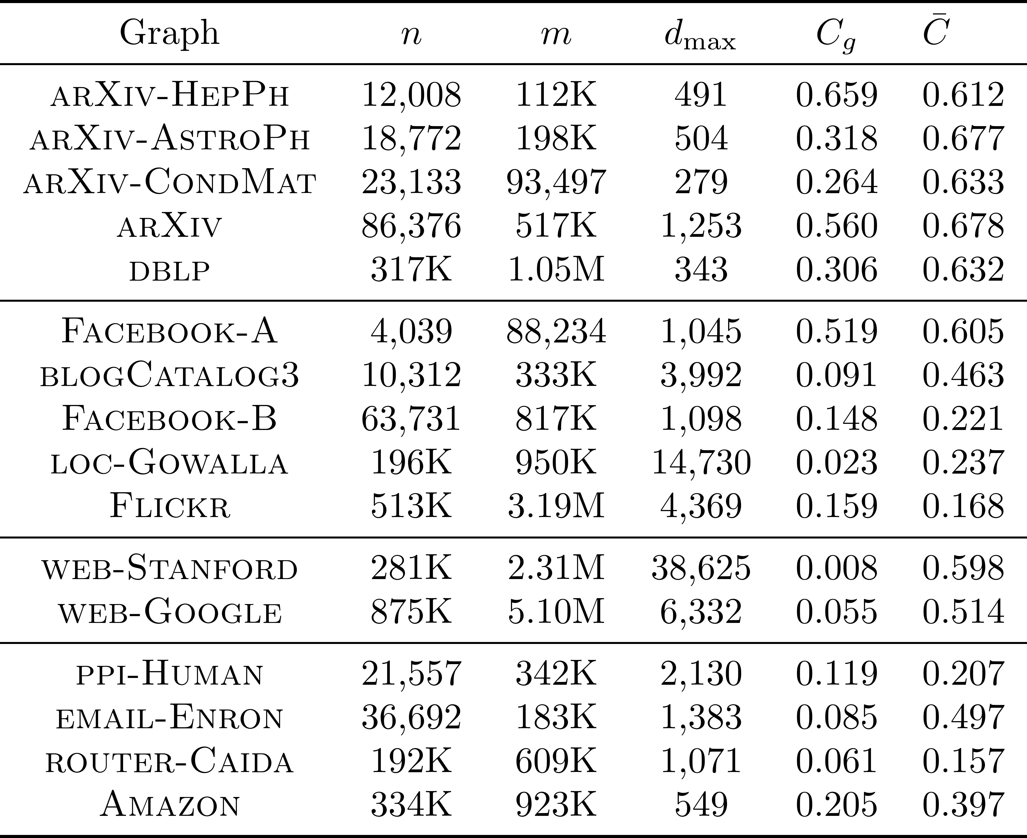
Experiments
Datasets:
What happens when GCC is small?

Slide 15
Experiments
Best neighborhood can still outperform a dedicated algorithm!
---Clique returned by GreedyOQC
[Tsourakakis et. al 2013]
---Max. degree
---GCC

Slide 16
Experiments
Use neighborhoods as seed sets for local search [Tsourakakis et al. 2013]
---Clique returned by GreedyOQC
[Tsourakakis et. al 2013]
---Max. degree
---GCC

Slide 17
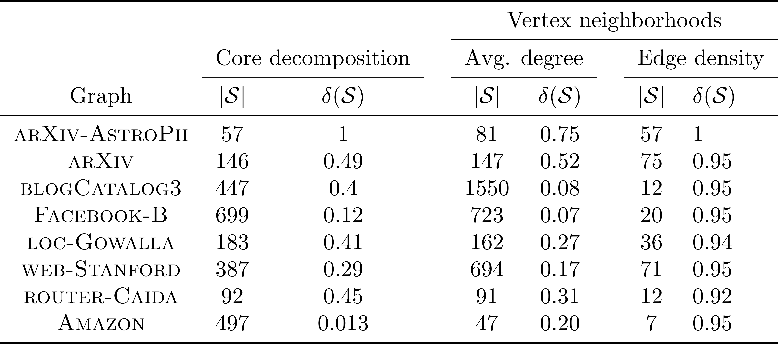
Comparing quality of seeds
Vertex neighborhoods are good seeds: Consistently yield seeds of considerably higher quality

Slide 18
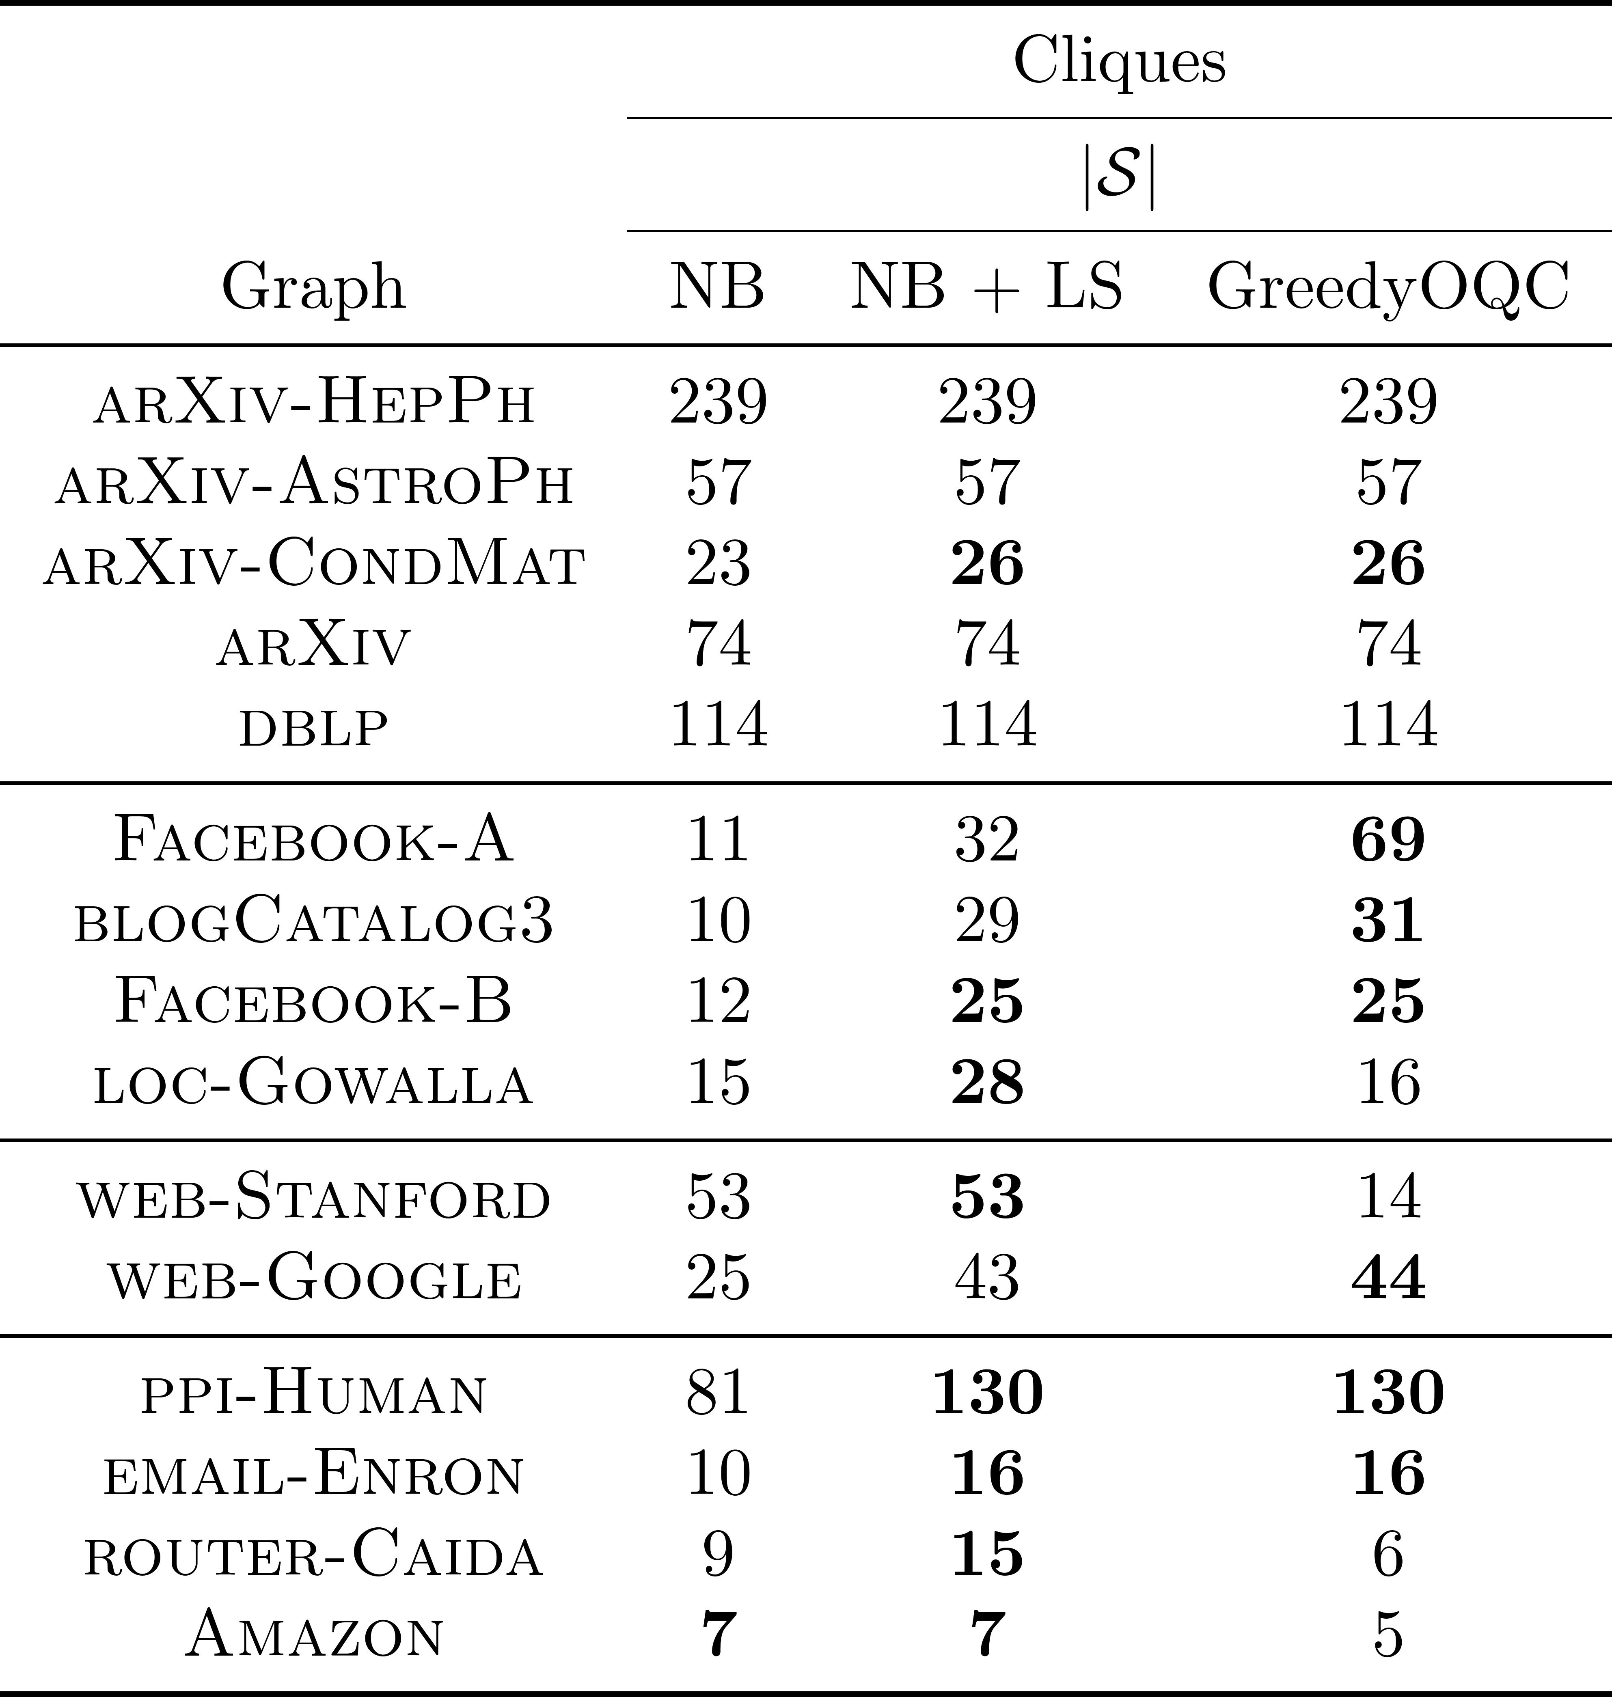
Results: cliques
Neighborhoods are dense subgraphs: Largest neighborhood cliques are no smaller than those computed by baselines on 6/15 datasets
Vertex neighborhoods are good seeds: Local search + proper seeds produce can produce
cliques of non-trivial sizes; competitive with greedyOQC

Slide 19
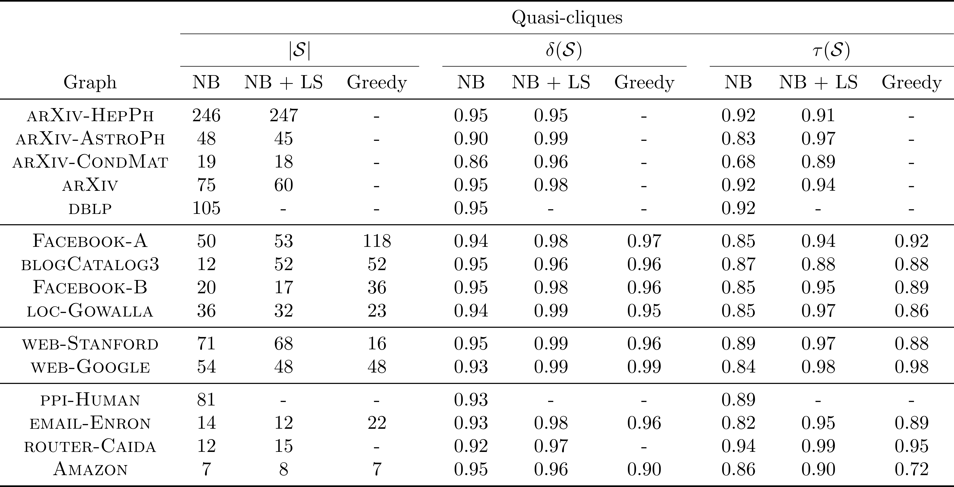
Results: quasi-cliques
Neighborhoods are dense subgraphs: Best neighborhood quasi-cliques are competitive in
general
Vertex neighborhoods are good seeds: Yield smaller quasi-cliques with higher triangle density compared to greedy
Greedy can fail to capture spectrum of subgraphs

Slide 20
Conclusions
Neighborhoods are dense subgraphs:
High clustering coefficients and power-law degree distributions imply that graphs harbor dense neighborhoods
In practice:
Neighborhoods can form large maximal cliques and quasi-cliques
Can serve as good seeds for local search
Combined approach yields state-of-the-art results
Simple methods work very well!
Future Work:
Additional theoretical analysis
Extensions to weighted, bipartite, time-evolving networks?

Slide 21
Thank you!

